Slide 1
Dollar Menu Money
Brandon Cornejo
Johnseth Chong
Joseph Mangahas
Sungbae Lee

Slide 2



01
Summary
Core Message
Our Hypothesis
02
Our Approach & Data
Our approach to answering questions
Databases used
03
Data Extraction, Cleanup, & Insight
Agenda
Exploration & cleanup process
Insights on the data
Problems we faced and how we resolved them
04
Data Analysis
Visualizations of our data
How we analyzed the data
05
Conclusion
Was our hypothesis correct?

Slide 3
Summary

Slide 4

Project Summary
“On any given day in the United States, an estimated 36.6% or approximately 84.8 million adults consume fast food”
– Cheryl Fryar, health statistician at the CDC
“America runs on fast food”
Fast food industry is a powerhouse with prevalence in all areas
Constantly growing
What areas are the fast food industry targeting?
Does the affordability of fast food create a higher demand in certain areas?
Our Hypothesis
We believe that the lower the average household income is in an area, the area will have a greater amount of fast food restaurants.

Slide 5
Our Approach & Data

Slide 6
Our Approach & Data
Approach:
Obtain census data for each area we would like to analyze
County
City
Create a code to pick 100 random cities and counties (each) from our list of data
Use Yelp’s API to conduct a for loop to grab the number of fast food restaurants per city/county
Analyze data
Databases Used:
YelpAPI
pip install yelpapi
Census Data
pip install census
Quarterly Census of Employment and Wages (QCEW) State and County Maps
https://beta.bls.gov/maps/cew/us
zip_bank_data.csv
CSV file used during in-class activity
06-Python-APIs\03-BankDeserts\10-Stu_BankDeserts_Heatmap\Resources

Slide 7
Data Extraction, Cleanup, & Insight

Slide 8
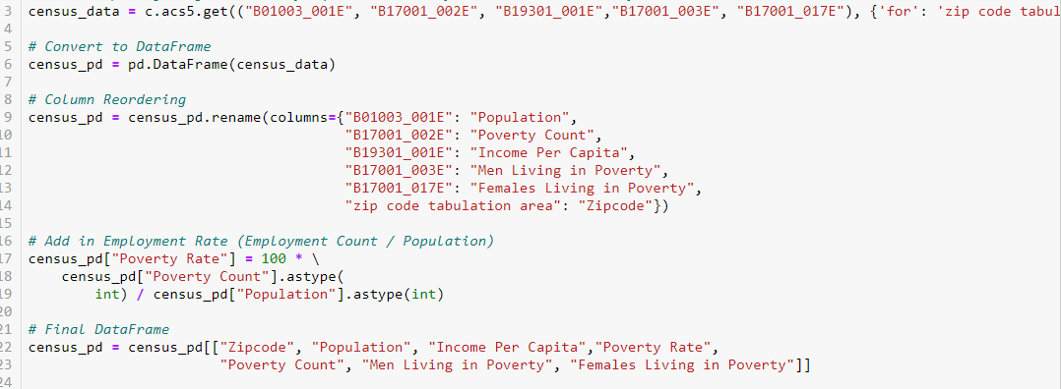
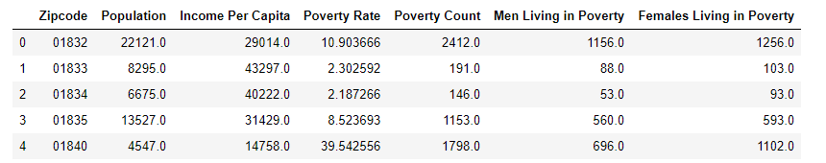
Extracting Data Using Census

Slide 9
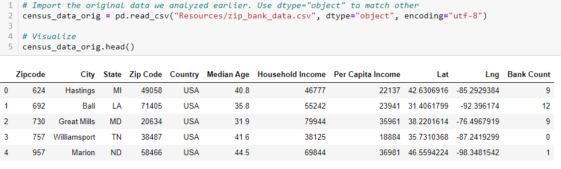
Import Additional Census Data via CSV

Slide 10
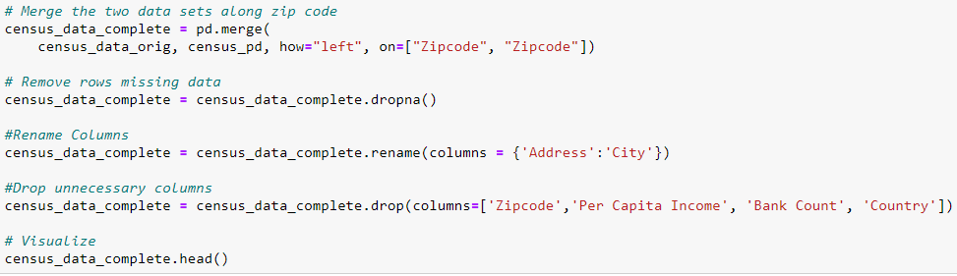
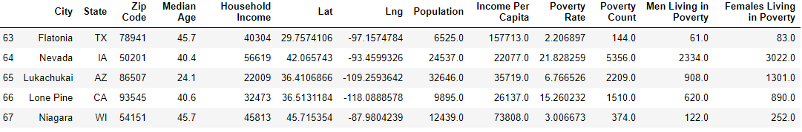
Merge DataFrames and Clean

Slide 11
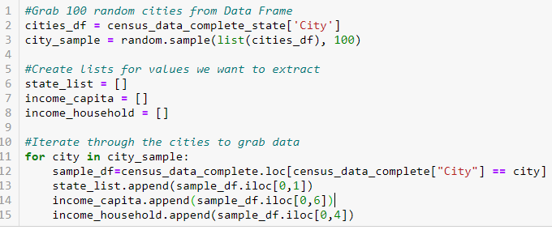
Grab 100 Random Cities From Data
Created lists to store relevant information during our for loop

Slide 12
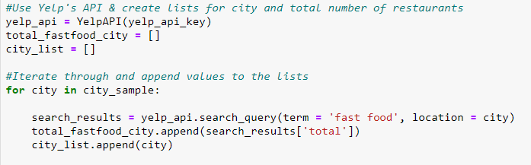
Grab 100 Random Cities From Data
Utilize Yelp’s API to obtain FF Restaurant values

Slide 13
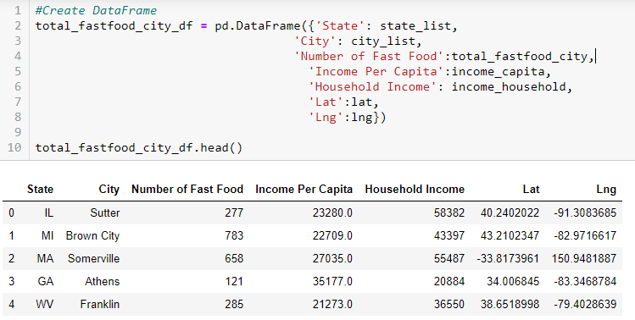
Create DataFrame

Slide 14
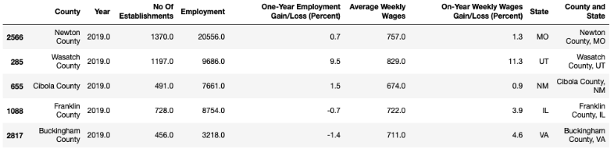
Problem & Resolution
We searched counties using Yelp API and our county wage data
Creating a dataframe gave errors regarding lists being of unequal sizes
After looking at the original data frame, we realized that there were multiple counties with the same name in different states
We resolved this by creating a new column that combines county and state, creating unique county values

Slide 15
Data Analysis

Slide 16
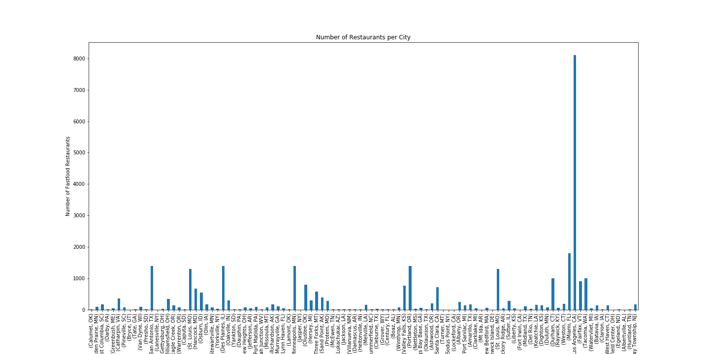

Slide 17
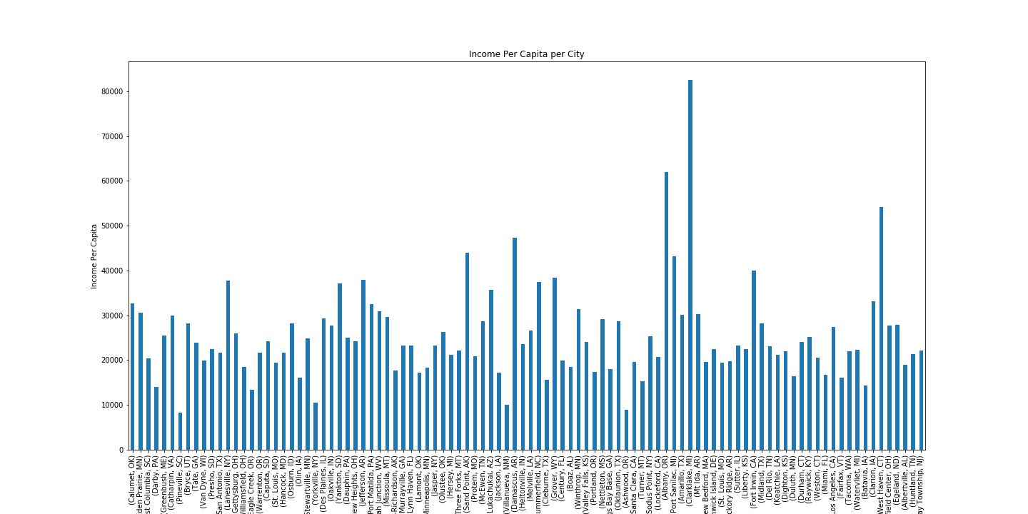

Slide 18
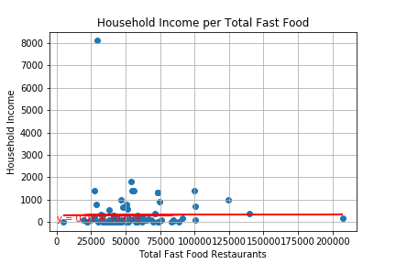
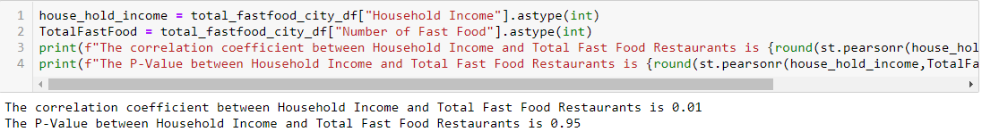
Y= 0.0x + 308.59

Slide 19
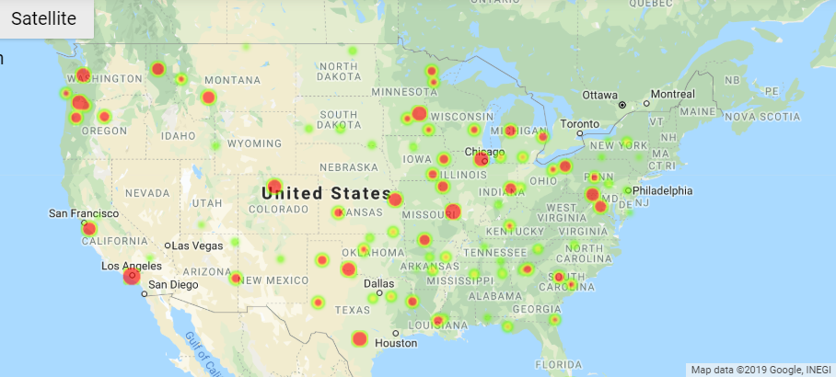
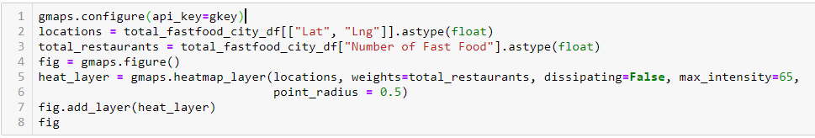
Heat Map for Number of Fast Food Restaurants by City

Slide 20
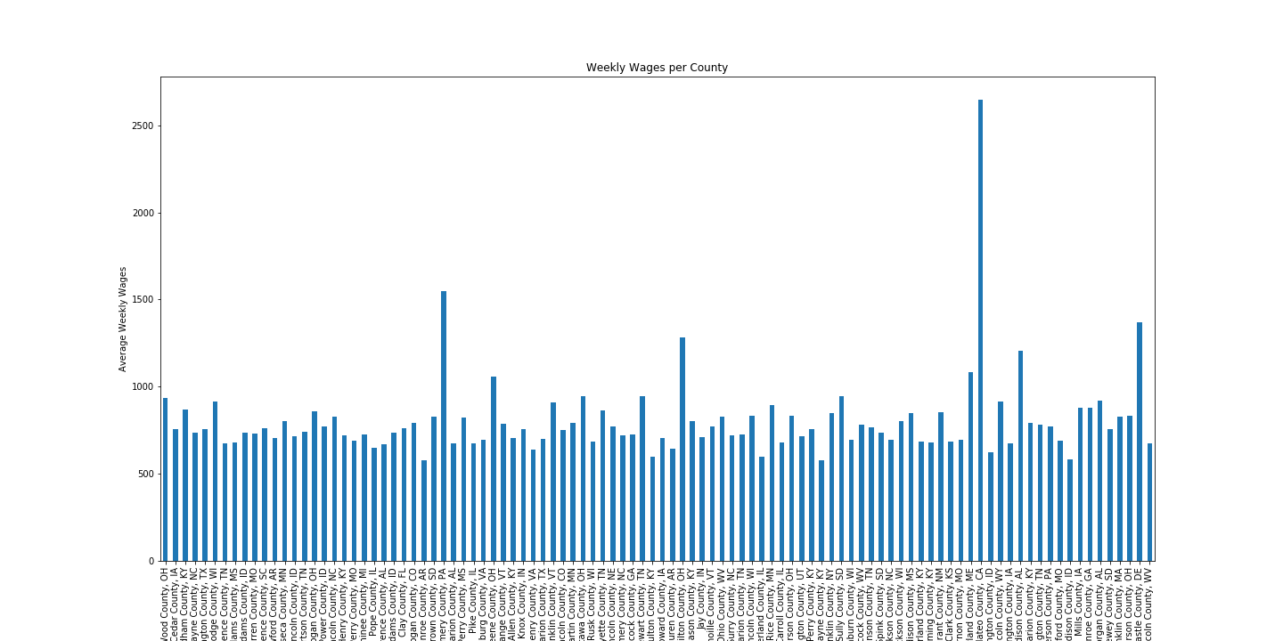

Slide 21
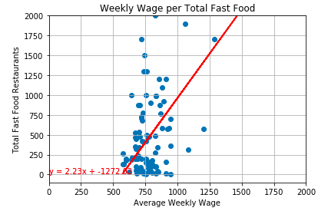

Slide 22
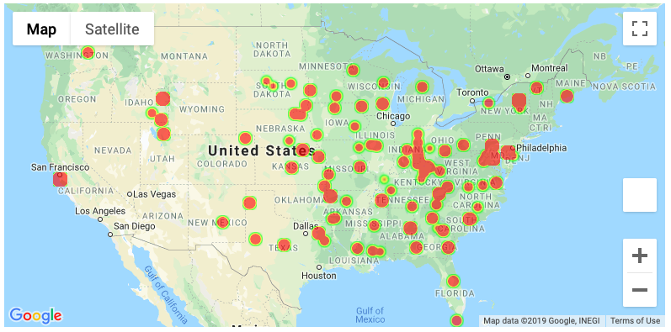
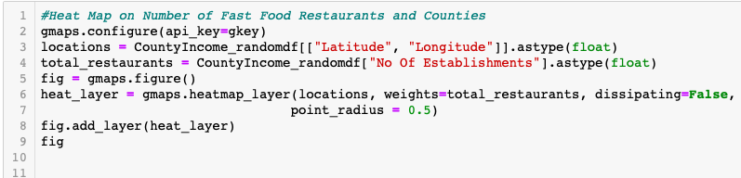
Heat Map for Number of Fast Food Restaurants by County

Slide 23
Conclusion

Slide 24
Conclusion
After a thorough analysis of our data, we have gained inconclusive evidence between low income areas and the amount of fast food restaurants.
For cities, the correlation coefficient between Household Income and Total Fast Food Restaurants is 0.01 and the P-Value is 0.95. In this sample we cannot conclude that there is a significant correlation between household income and fast food restaurants.
For counties, the correlation coefficient between Weekly Wages and Total Fast Food Restaurants is 0.76 and the P-Value is 0.00. In this sample there is evidence to suggest that there is a relationship between Weekly Wages and numbers of fast food restaurants per county. However, the positive correlation coefficient suggests that the number of fast food restaurants increases as Weekly Wages increases.

Slide 25
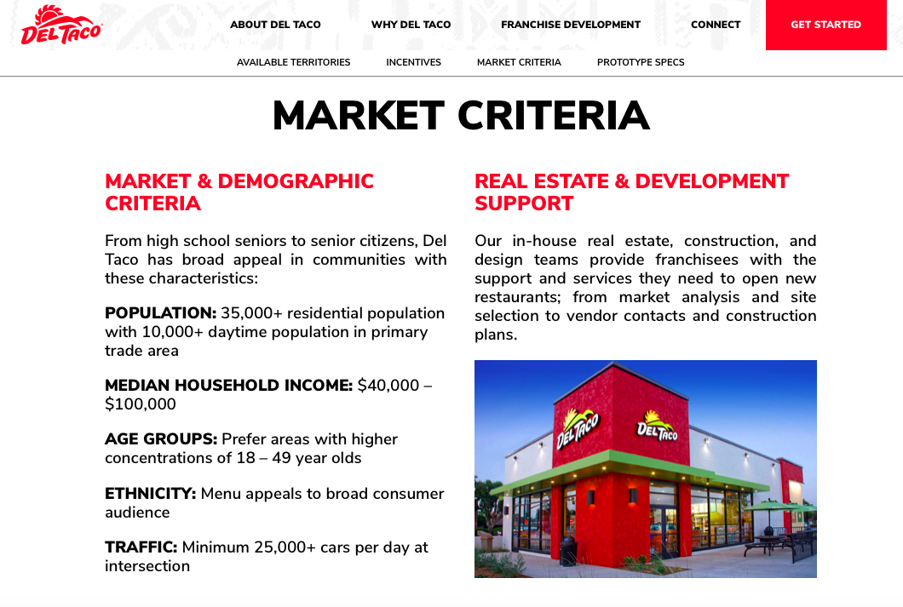

Slide 26
